Slide 1



ICS141:
Discrete Mathematics for Computer Science I
Modified Slides (based on the source mentioned below):
Originals slides by Dr. Baek and Dr. Still, adapted by J. Stelovsky
Based on slides Dr. M. P. Frank and Dr. J.L. Gross
Provided by McGraw-Hill

Slide 2

Lecture 11
Chapter 5 (or, 4 or, 6). Counting
Permutations and Combinations

Slide 3


Permutations
 A permutation of a set S of distinct elements is an ordered sequence that contains each element in S exactly once.
 E.g. {A, B, C} → six permutations:
ABC, ACB, BAC, BCA, CAB, CBA
 An ordered arrangement of r distinct elements of
S is called an r-permutation of S.
 The number of r-permutations of a set with n = |S| elements is
n! (n − r)!
P(n, r) = n(n −1)(n − 2)…(n − r +1) =
, 0 ≤ r ≤ n .
 P(n,n) = n!/(n – n)! = n!/0! = n! (Note: 0! = 1)

Slide 4

Permutation Examples
 Example: Let S = {1, 2, 3}.
 The arrangement 3, 1, 2 is a permutation of S (3! = 6 ways)
 The arrangement 3, 2 is a 2-permutation of S (3·2=3!/1! = 6 ways)
 Example: There is an armed nuclear bomb planted in your city, and it is your job to disable it by cutting wires to the trigger device. There are 10 wires to the device. If you cut exactly the right three wires, in exactly the right order, you will disable the bomb, otherwise it will explode! If the wires all look the same, what are your chances of survival?
P(10,3) = 10×9×8 = 720,
so there is a 1 in 720 chances that you’ll survive!

Slide 5

More Permutation Examples
 Example: Suppose that a salesman has to visit eight different cities. He must begin his trip in a specified city, but he can visit the other seven cities in any order he wishes. How many possible orders can the salesman use when visiting these cities?
First city is determined, and the remaining seven can be ordered arbitrarily: 7! = 7·6·5·4·3·2·1 = 5040
 Example: How many permutations of the letters ABCDEFGH contain the string ABC?
ABC must occur as a block, i.e. consider it as one object Then, it’ll be the number of permutations of six objects (ABC, D, E, F, G, H), which is 6! = 720

Slide 6
Another Example
 How many ways are there to pick a set of 3 people from a group of 6?
 There are 6 choices for the first person, 5 for the second one, and 4 for the third one, so there are 6⋅5⋅4 = 120 ways to do this.
 This is not the correct result!
 For example, picking person C, then person A, and then person E leads to the same group as first picking E, then C, and then A.
 However, these cases are counted separately in the above equation.
 So how can we compute how many different subsets of people can be picked (that is, we want to disregard the order of picking)?

Slide 7

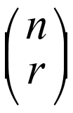
Combinations
 An r-combination of elements of a set S is an unordered selection of r elements from the set. Thus, an r-combination is simply a subset T⊆S with r members, |T| = r.
 Example: S = {1, 2, 3, 4}, then {1, 3, 4} is a 3-combination from S
 Example: How many distinct 7-card hands can be drawn from a standard 52-card deck?
 The order of cards in a hand doesn’t matter.
 Notation: C(n, r) or , where n = 52 and r = 7
$C(n,r)$ is also known as the binomial coefficient, $\left({n \atop r}\right)$

Slide 8
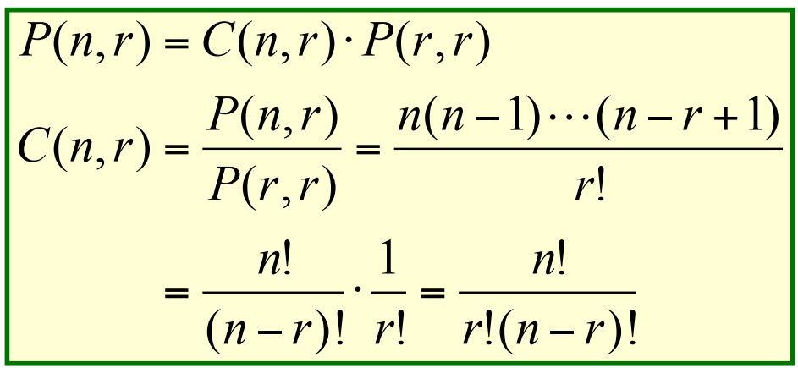
Calculate C(n, r)
 Consider that we can obtain the r-permutation of a set in the following way:
 First, we form all the r-combinations of the set (there are C(n, r) such r-combinations)
 Then, we generate all possible orderings in each of these r-combinations (there are P(r, r) such orderings in each case).
 Therefore, we have:

Slide 9
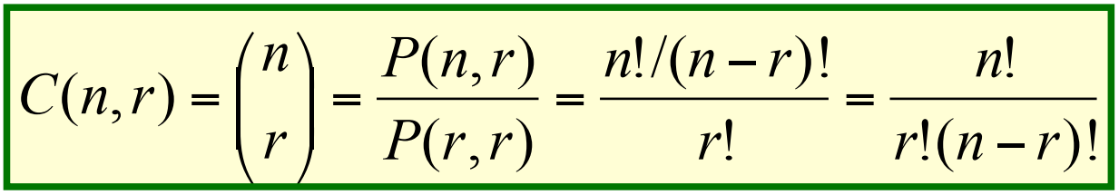
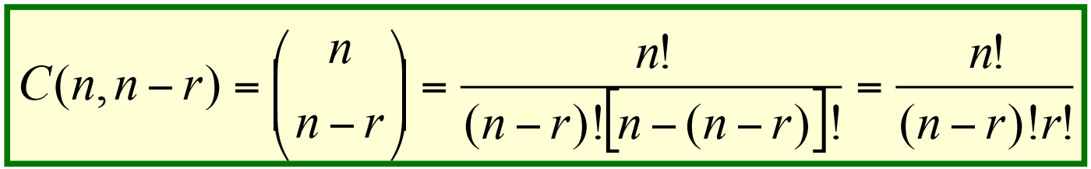
Combinations
 The number of r-combinations of a set with
n = |S| elements is,
 Note that C(n, r) = C(n, n − r) Because choosing the r members of T is the same thing as choosing the (n − r) non- members of T.
* Symmetry of binomial coefficient

Slide 10

Combinations
 Prove that $C\left(n,r\right)=C\left(n−1,r\right)+C(n−1,r−1)$ Recurrence of binomial coefficient
See sample solution provided.

Slide 11
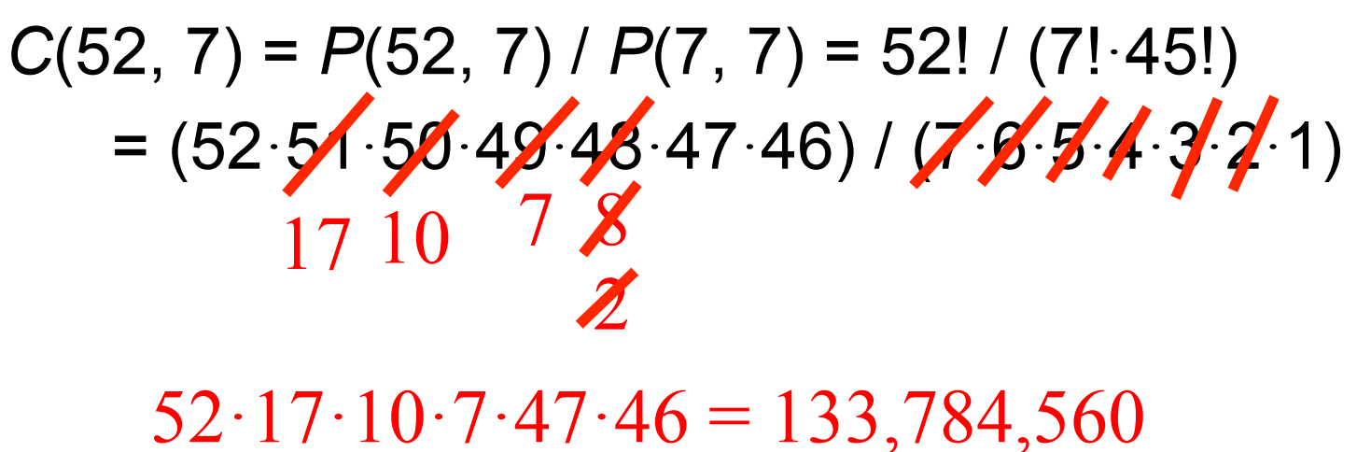
Combination Example I
 How many distinct 7-card hands can be drawn from a standard 52-card deck?
 The order of cards in a hand doesn’t matter.
 Answer:

Slide 12
Combination Example II
 C(4, 3) = 4, since, for example, the 3-combinations of a set {1, 2, 3, 4} are {1, 2, 3}, {1, 3, 4}, {2, 3, 4}, {1, 2, 4}.
 C(4, 3) = P(4, 3) / P(3, 3) = 4! / (3! × 1!)
= (4 × 3 × 2) / (3 × 2 × 1) = 4
 How many ways are there to pick a set of 3 people from a group of 6 (disregarding the order of picking)?
 C(6, 3) = 6! / (3! × 3!)
= (6 × 5 × 4) / (3 × 2 × 1) = 20
 There are 20 different groups to be picked

